Slide 1

Bombastic Bookstore
Group 2

Slide 2
Introduction
Bombastic Bookstore is a web based bookstore project. It is designed to allow for all-online browsing, searching, and ordering from a catalog of books. Users are able to register and log in to the site. For it’s administrators, it has a backend with fancy graphs and visualizations

Slide 3
Group 2
Project Manager: Taylor Sanderson
Mentor: Eddie Laczynski
Team Members:
Daniel Stanton
Matthew Wilamowski
Stefan Slaczka
Tanner Plishka

Slide 4
Team Collaboration
Tools used:
GitHub
Practera
Trello
Microsoft Teams
Twice Weekly team meetings via Teams
Shared work accomplished and planed for work done next half-week
Code hosting by Github
Many short-lived branches used to maintain parallel development

Slide 5

Project Overview
Online Bookstore
Search functionality
Working Cart and payment with input verification
User login, registration, and profiles
Admin pages
Inventory monitoring
Sales visualizations
Notes:
Tanner

Slide 6
Development process
Methodology: Agile development split into five two-week sprints.
Timeline: Project commenced on January 20th with a kickoff meeting. It concluded on April 21st with the submission of the project files.
Challenges:
A full app rebuild halfway through to make user logins work
Branch merge issues
Script data import issues with 1000 book catalog
Interacting with OpenLibrary API for book data
Parsing the results was also difficult. OpenLibrary has a LOT of data.
Interacting with the Google API to pull book descriptions

Slide 7
Milestones
Sprint 1 saw the completion of a basic web app, the beginning of the database, and book catalog.
Sprint 2 saw the combining of the catalog script with the database and the first site CSS
Sprint 3 saw individual book info pages, as well as a working cart and checkout.
Sprint 4 saw working search, and an entire app refactor into a more modern design.
Sprint 5 saw all the visualizations functional, and final testing of the project.

Slide 8
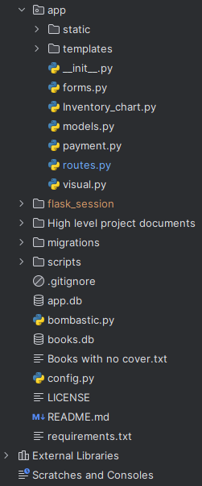
Architecture and Design
Flask was the underlying framework utilized, with extensions added as needed to support intended functionality.
Initial structure of program was haphazard with little cohesion - refactoring the program allowed us to bring it more inline with common Flask application structure & prevent circular import errors.
Main structure
__init__ - resources and extensions are loaded and defined
forms - login and registration forms are defined
routes - vast majority of functions and url routing
models - user database modeling and interaction
payments - credit card payments and processing
visuals - generates infographics for admin use
bombastic - defines the application instance & facilitates manipulation of user database via the Python console
Noteworthy template files
base - allows for template inheritance. Functionally, adds navigation and search bar to each page
Notes:
Matthew

Slide 9
Key Features
Online Bookstore
Allows users to browse, search, and select the books they want to purchase.
Search functionality
Allows for searching the catalog by author, title, or genre.
Working Cart and payment with input verification
Maintains user cart throughout the site and across multiple sessions on the site
Payment page checks for valid credit card numbers
User login, registration, and profiles
Users are able to sign up to the site using the registration page and have a profile with an avatar pulled from Gravatar. Their login info is kept in a database across sessions on the site.
Admin pages
Inventory monitoring allows the bookstore owner to maintain stock levels of each book in the catalog.
Sales visualizations allow the bookstore admin to see what is selling and what is not, and see sales trends over time.

Slide 10
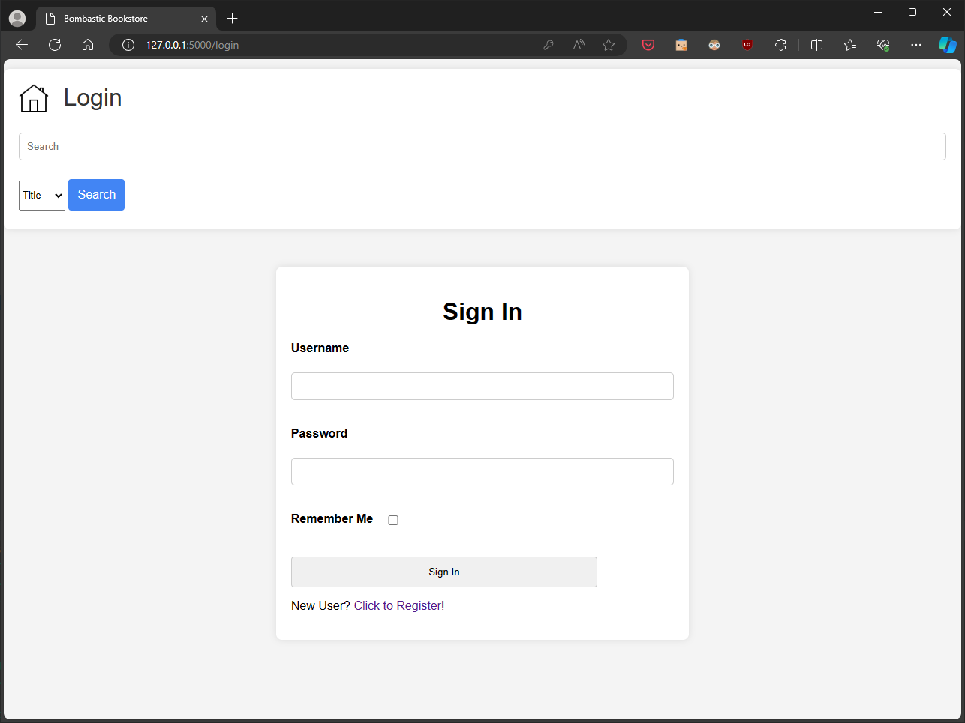
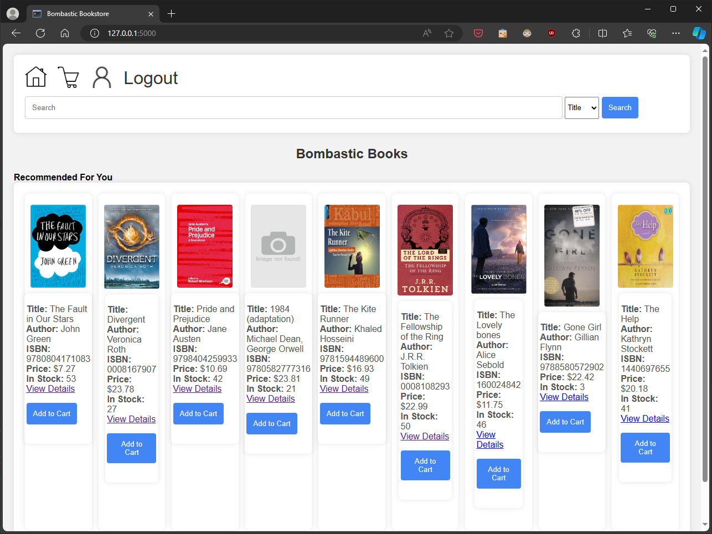
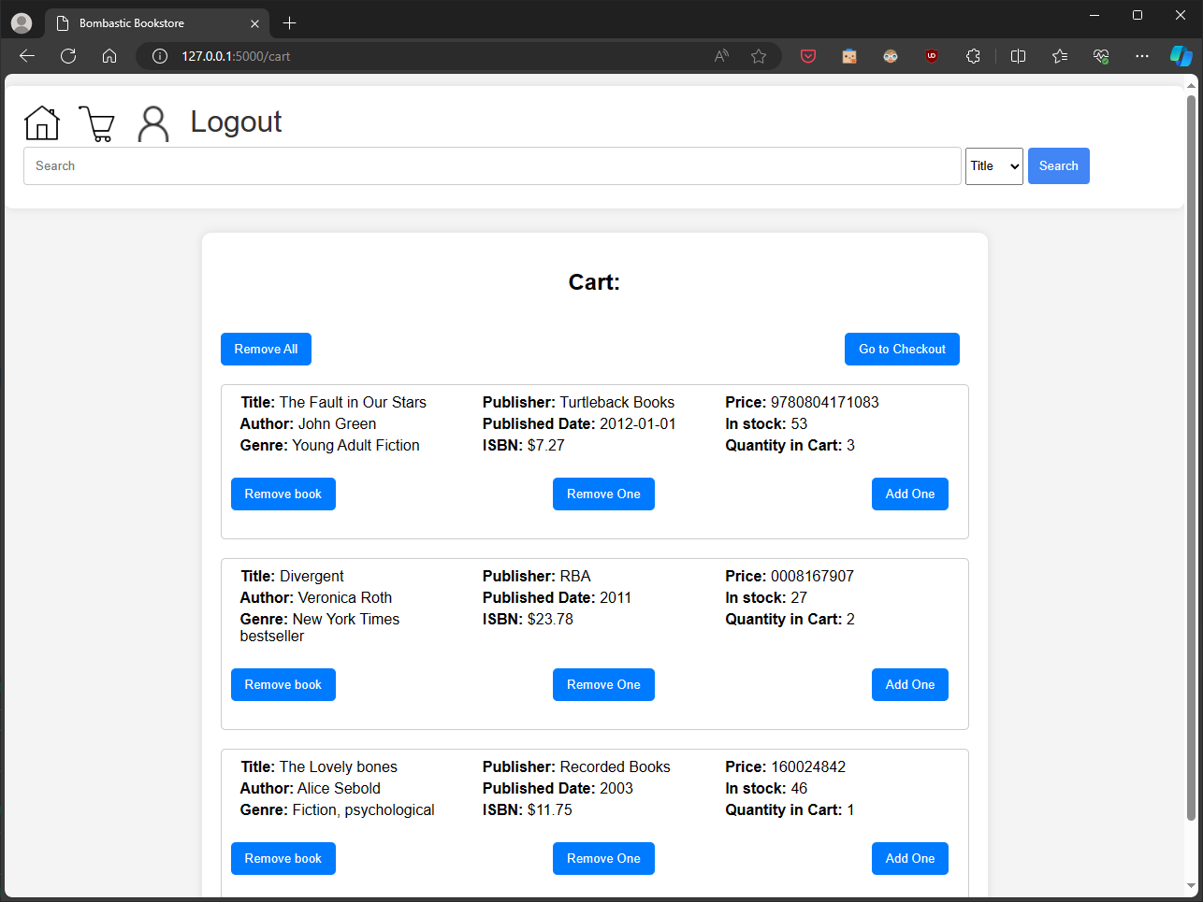
UI
Login
Front page
Shopping cart
Notes:
Tanner

Slide 11
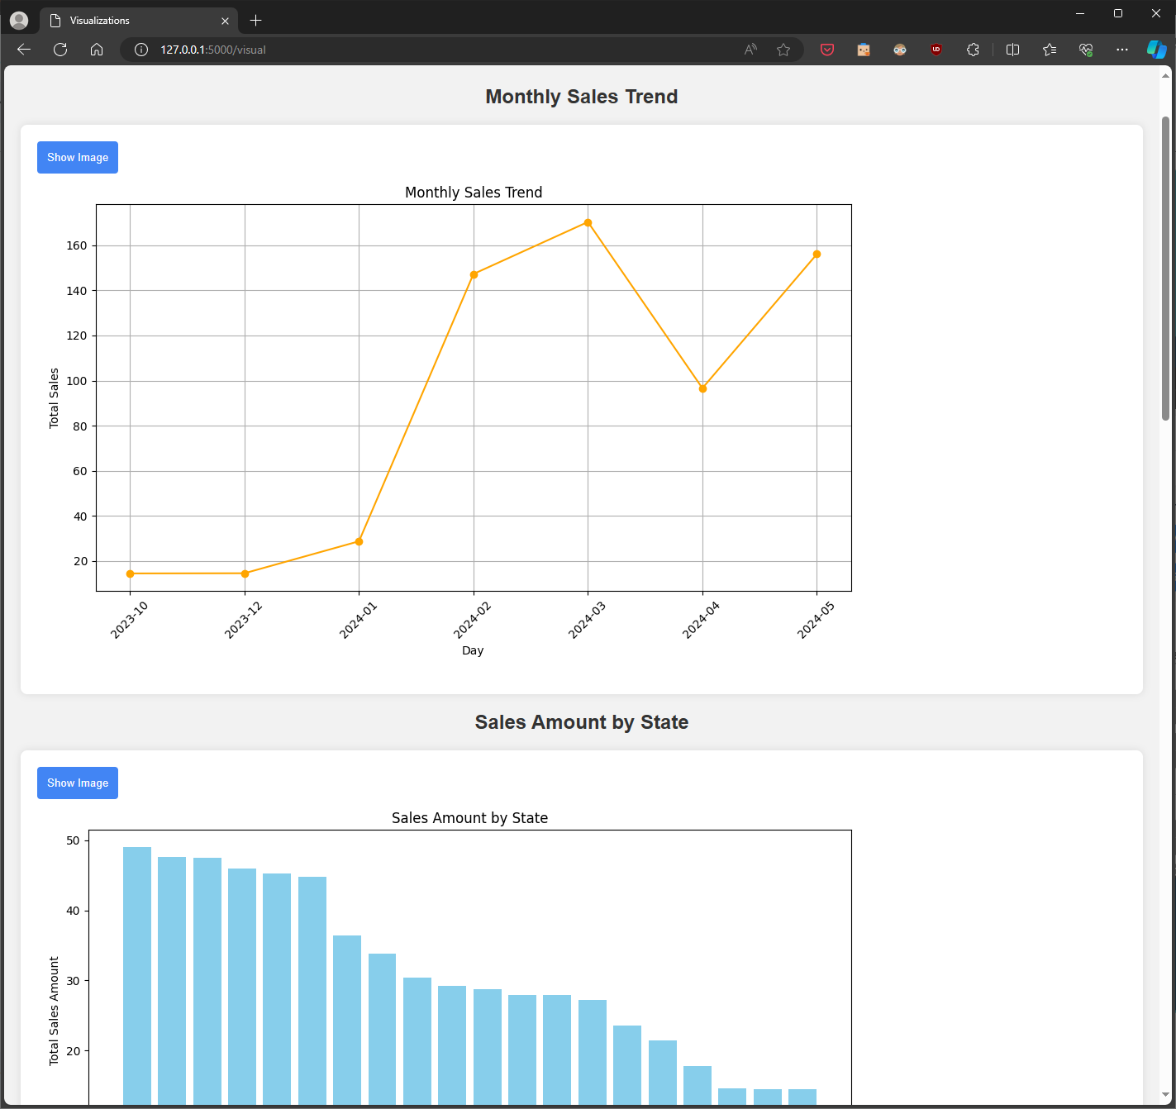
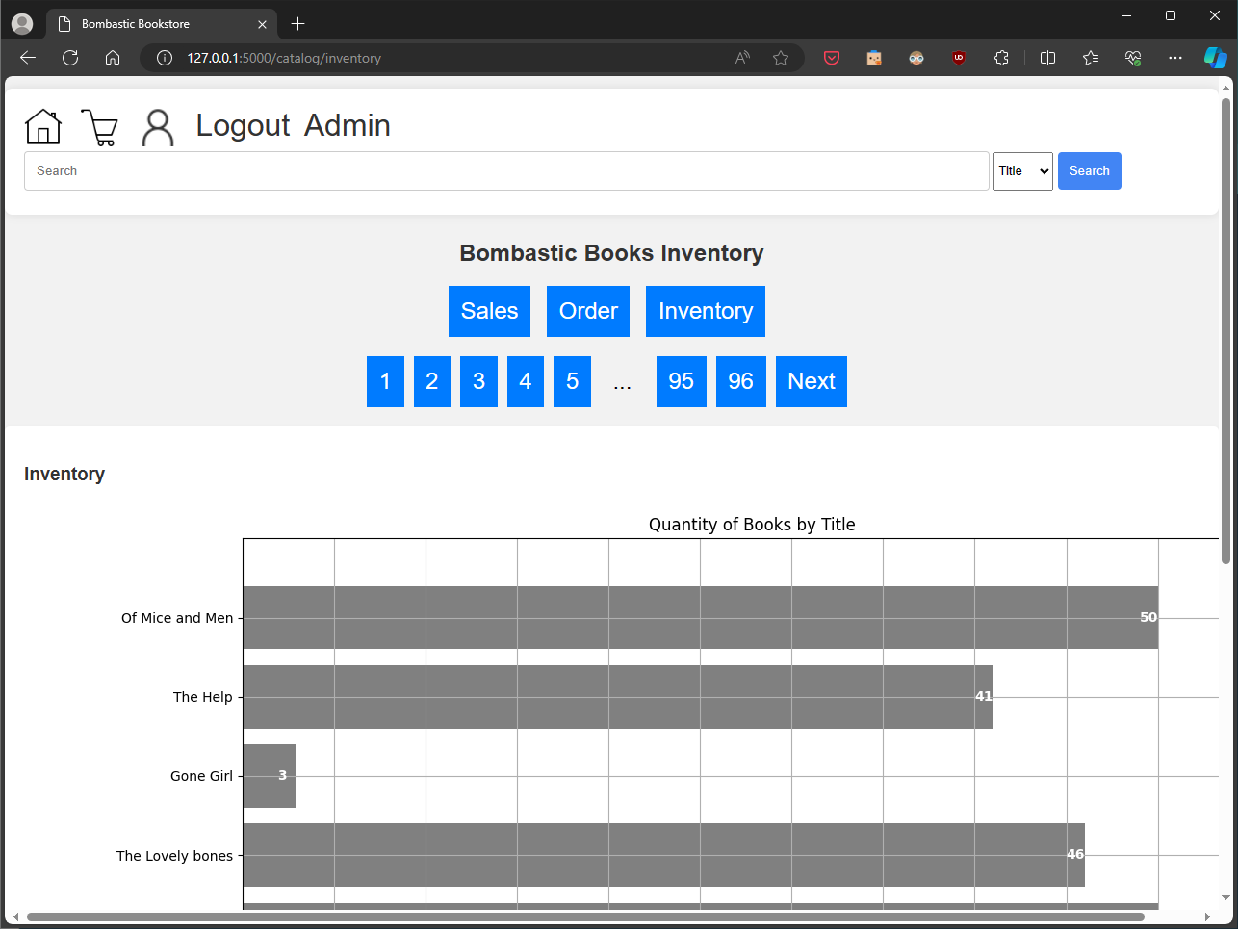
Reports
Notes:
Tanner

Slide 12
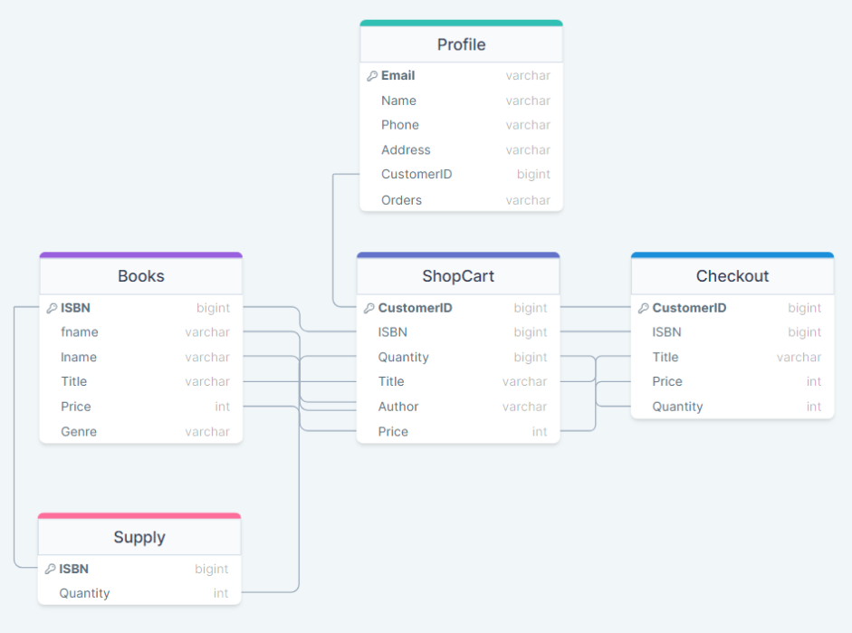
Database usage
DB plan before programming began
SQLite Database used for ease of programming
SQLAlchemy used for user data handling, interacting with the SQLite DB
Book inventory data stored in DB
Customer login info stored securely in DB
Shopping carts accomplished using Cookies instead of DB entries
Notes:
Daniel

Slide 13
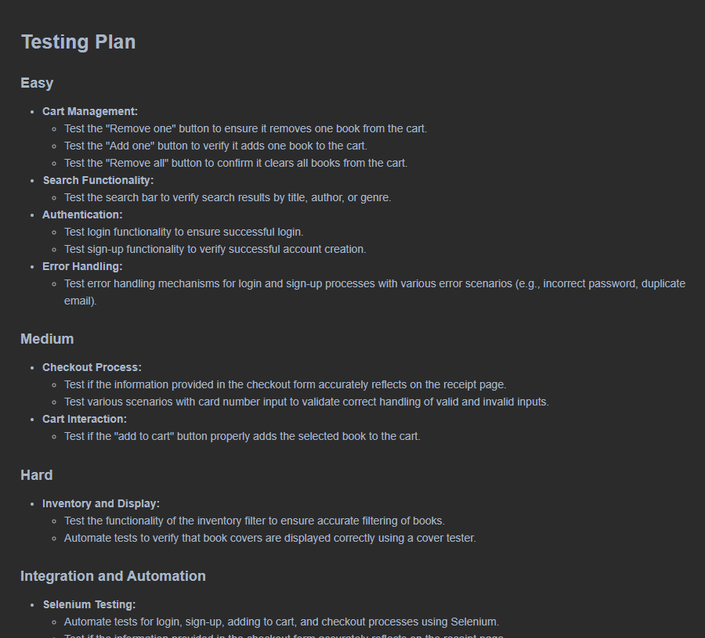
Testing and quality assurance
The written testing plan
Black box testing on many aspects of the application was done late in the project to verify that everything functioned as intended
Very few bugs were revealed by this process, most had been identified beforehand and fixed.
Notes:
Stefan

Slide 14
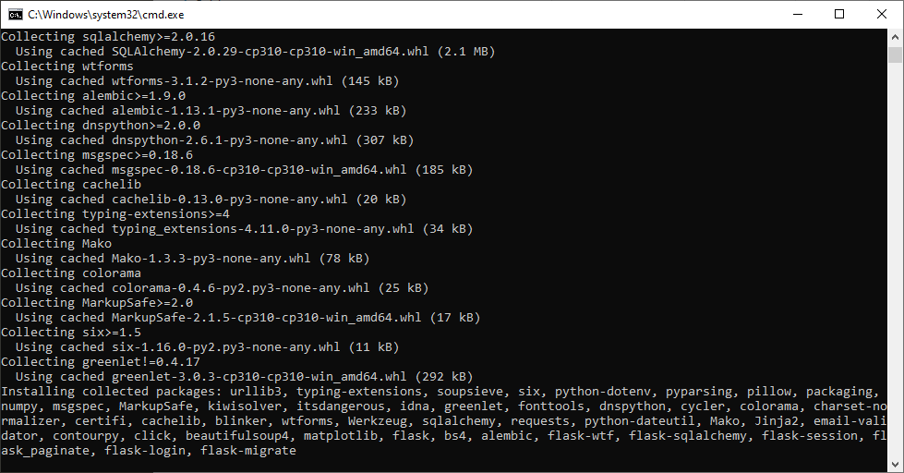
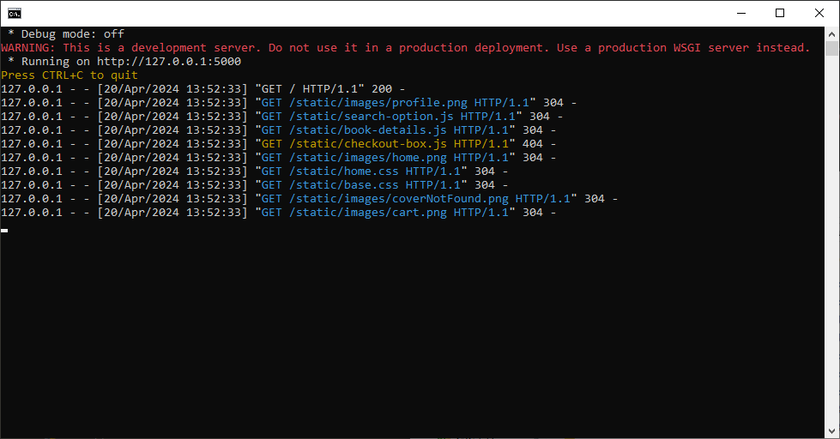
Deployment
Bombastic Bookstore is easily deployable using a simple .bat script in the root folder.
Notes:
Daniel

Slide 15
Future Development Plan and Q&A
Future Development Plan
Q&A
Filtering and sorting for the admin catalog page stalled and was not included in the final product. Would like to add if given more time.
Purchases don’t currently affect stock levels.
Admin ability to adjust stock levels on the backend without directly modifying the DB
More visualizations
Purchase log with shipping management
Payment processor integration
Book rental
How do you plan to implement cloud deployment in the future?
We experimented with cloud deployment but ran into the problem of having to sort out SSL certificates for the site due to the modern web needing HTTPS. The application is ready for deployment to the cloud if this is sorted out.
How secure is your login system?
Our passwords are properly hashed and stored by the application as is industry standard.
Why Flask instead of DJango?
Flask is a simpler framework to work with without sacrificing any of the functionality we needed to put together our application.

